Slide 1




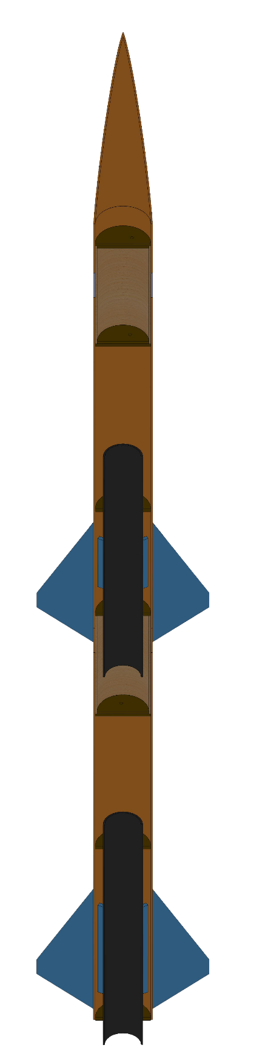
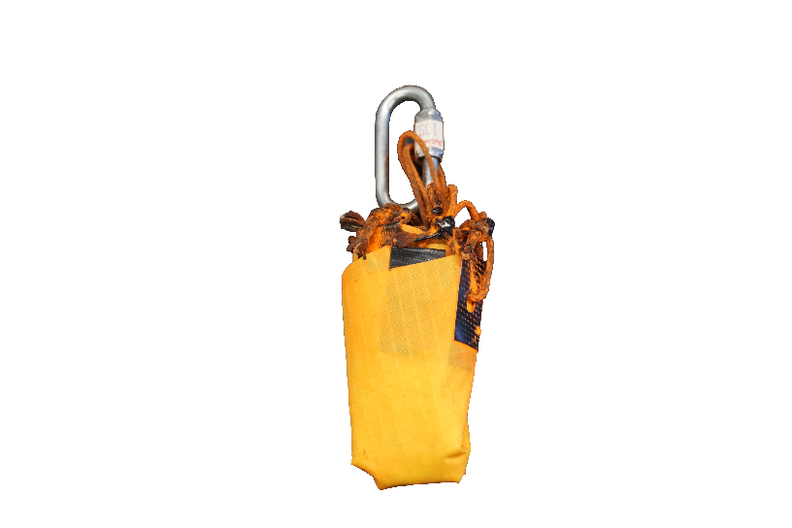
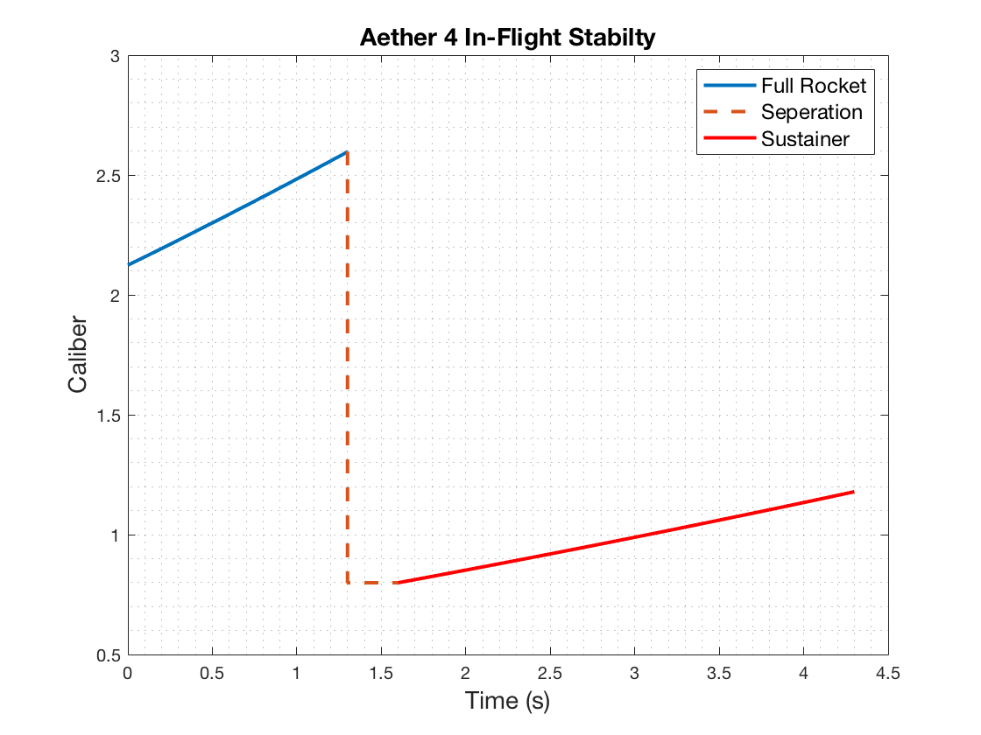
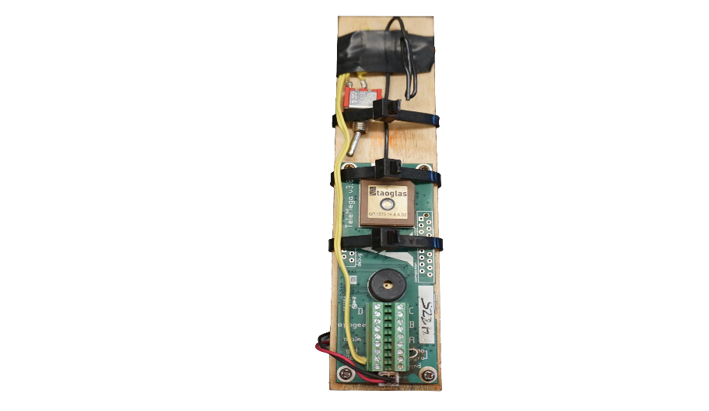
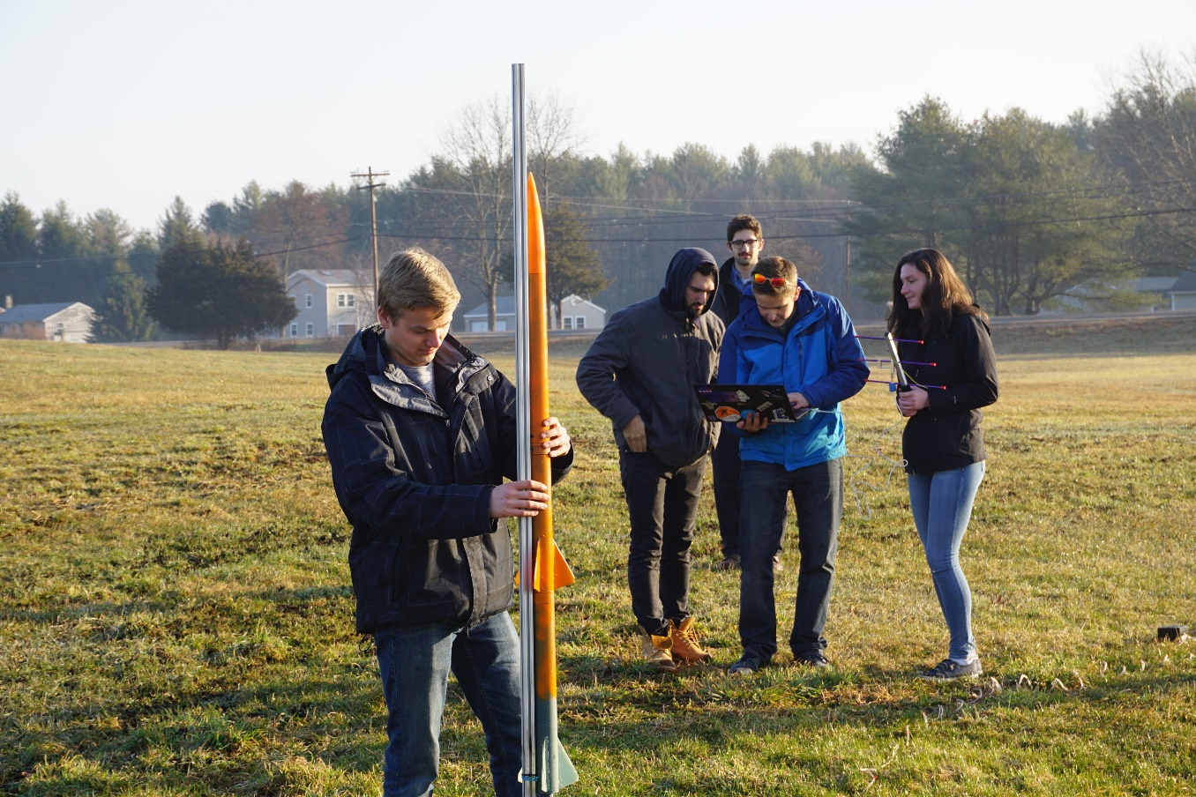
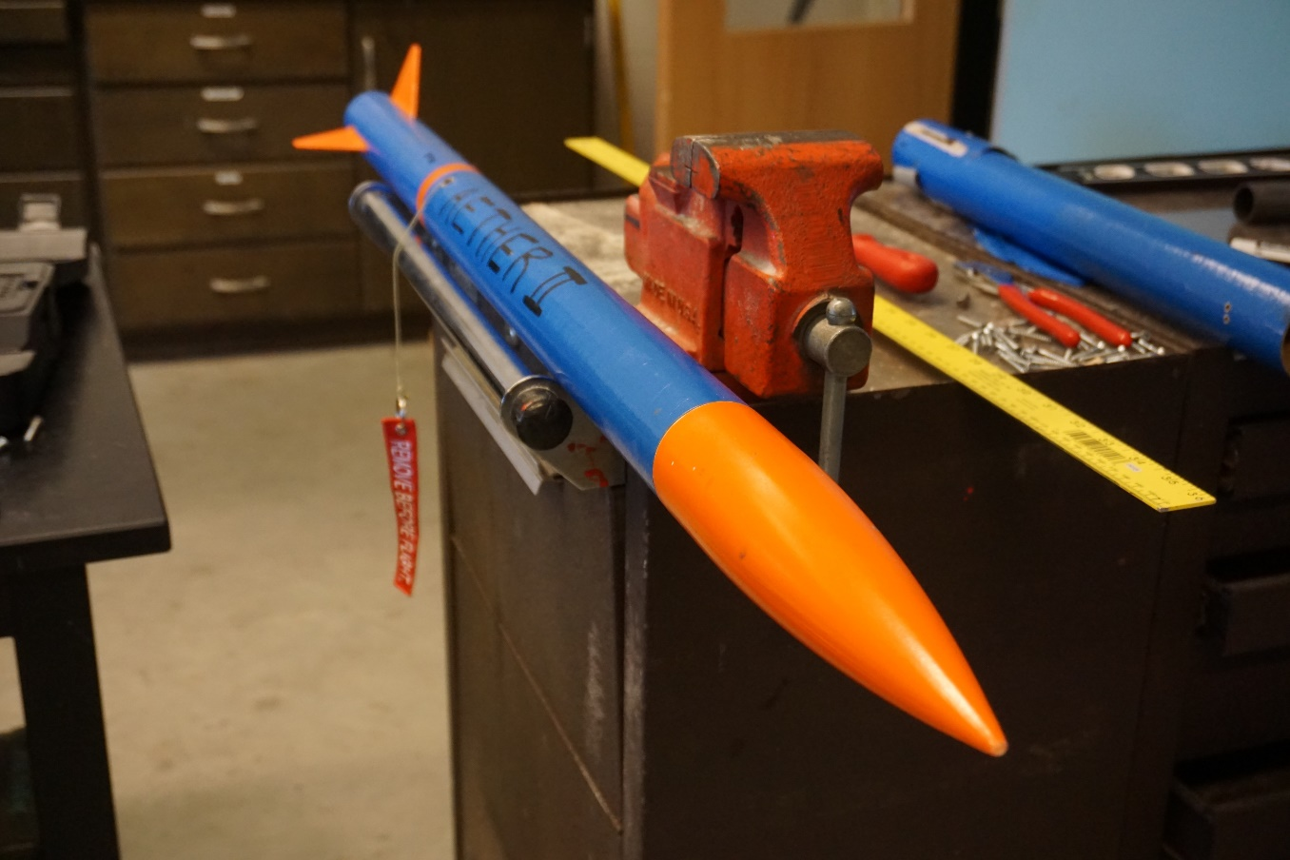
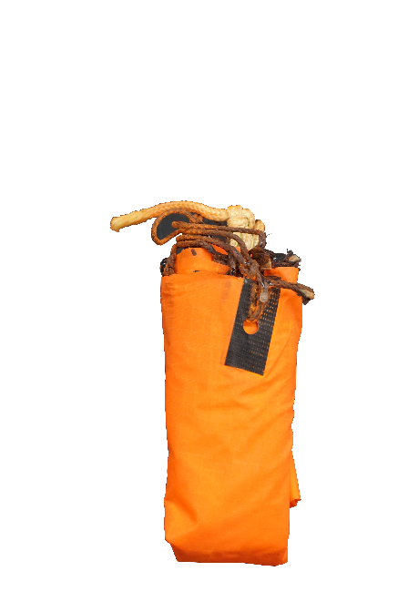
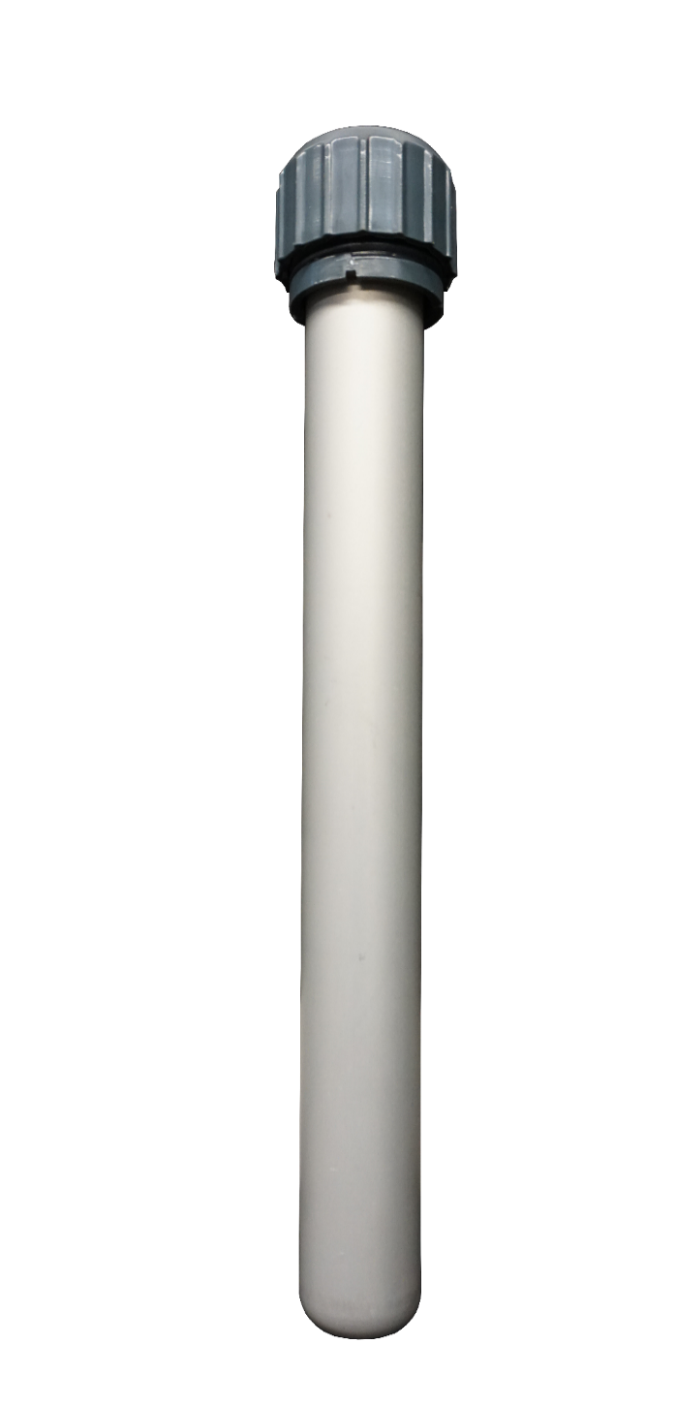
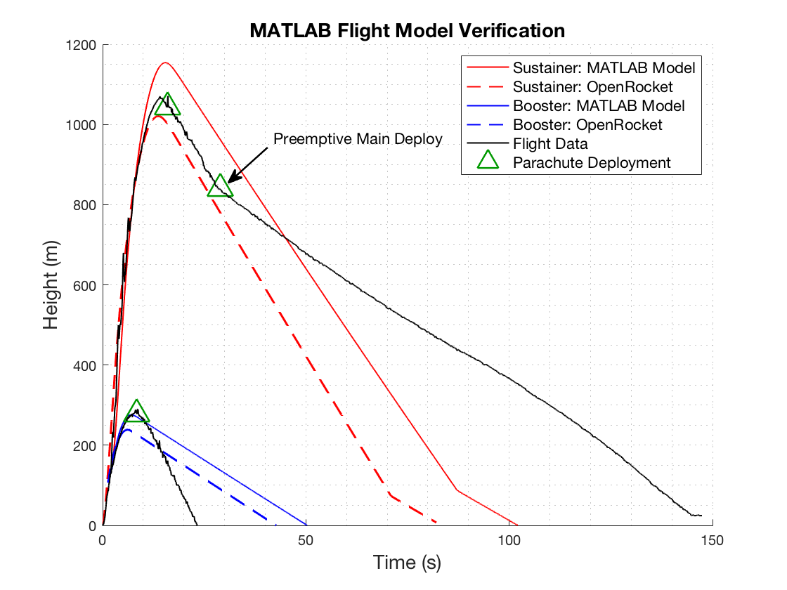
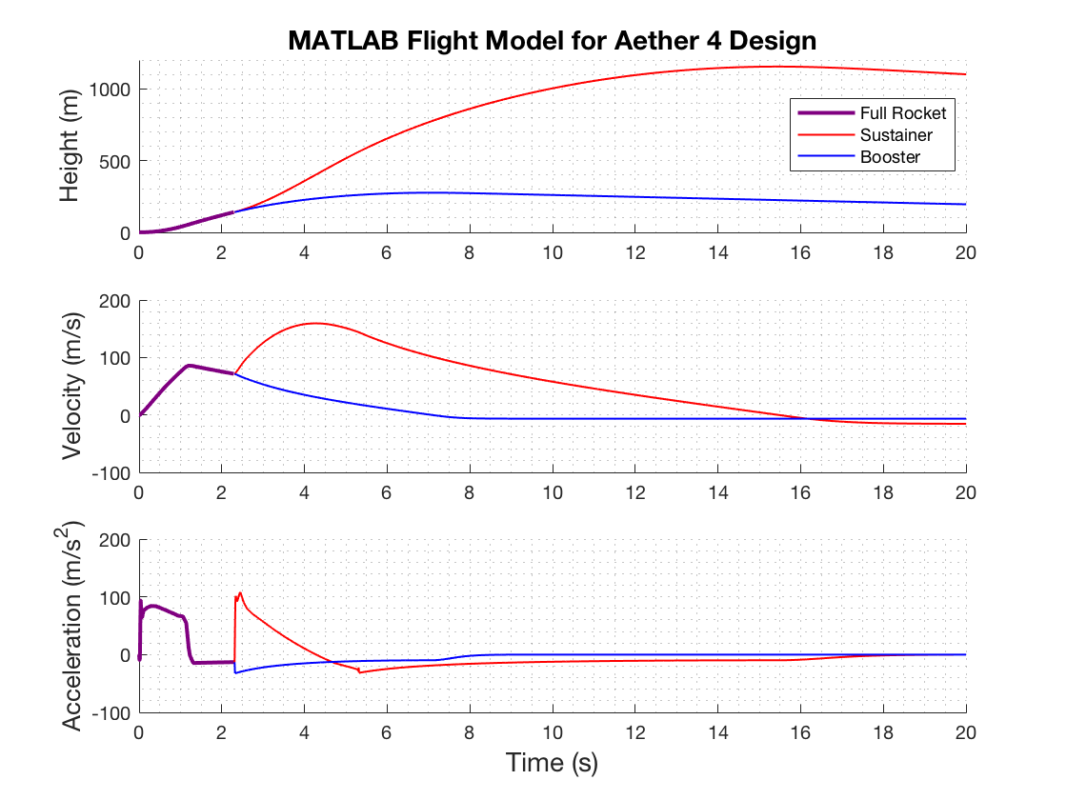
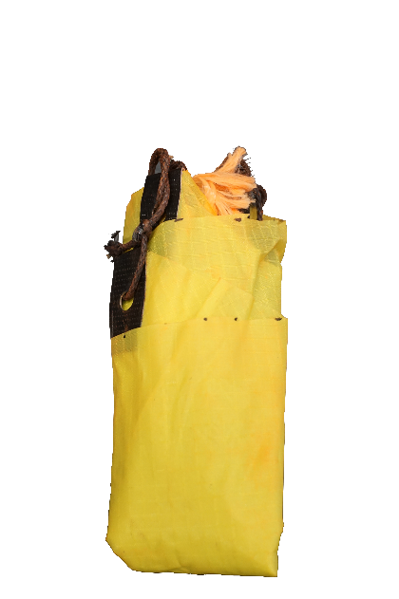

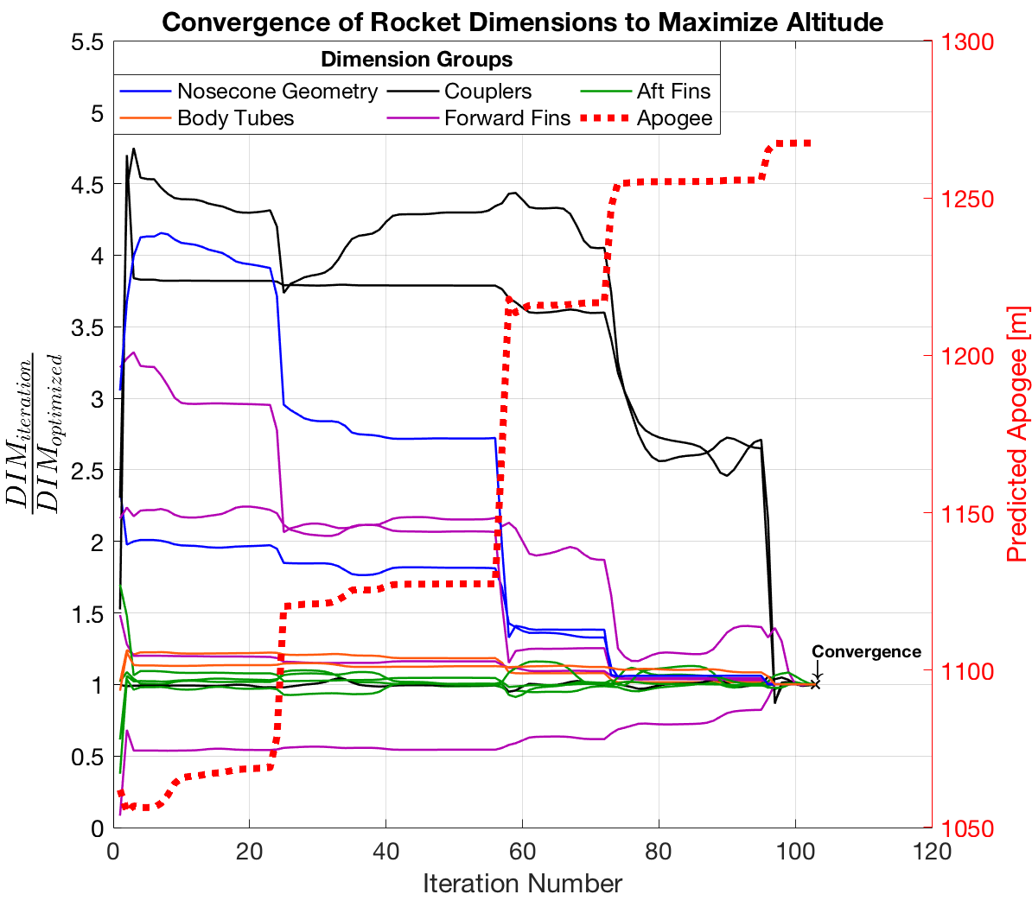

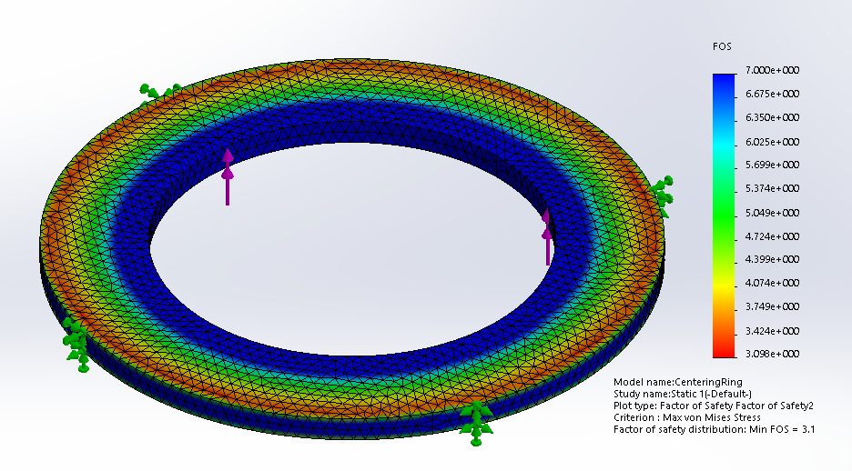
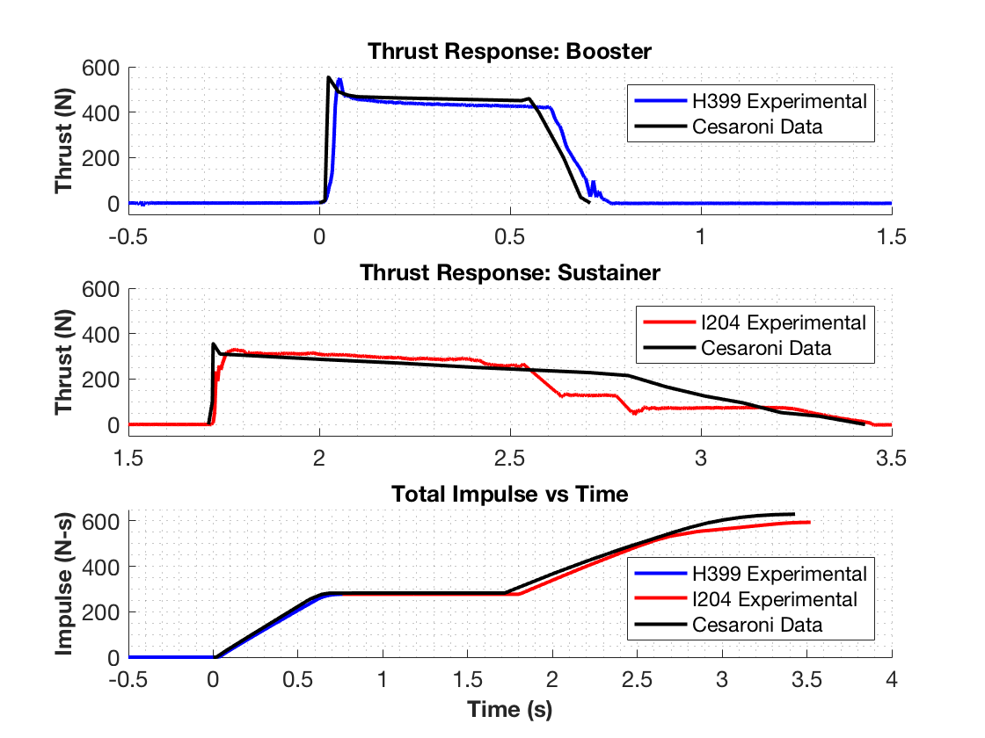
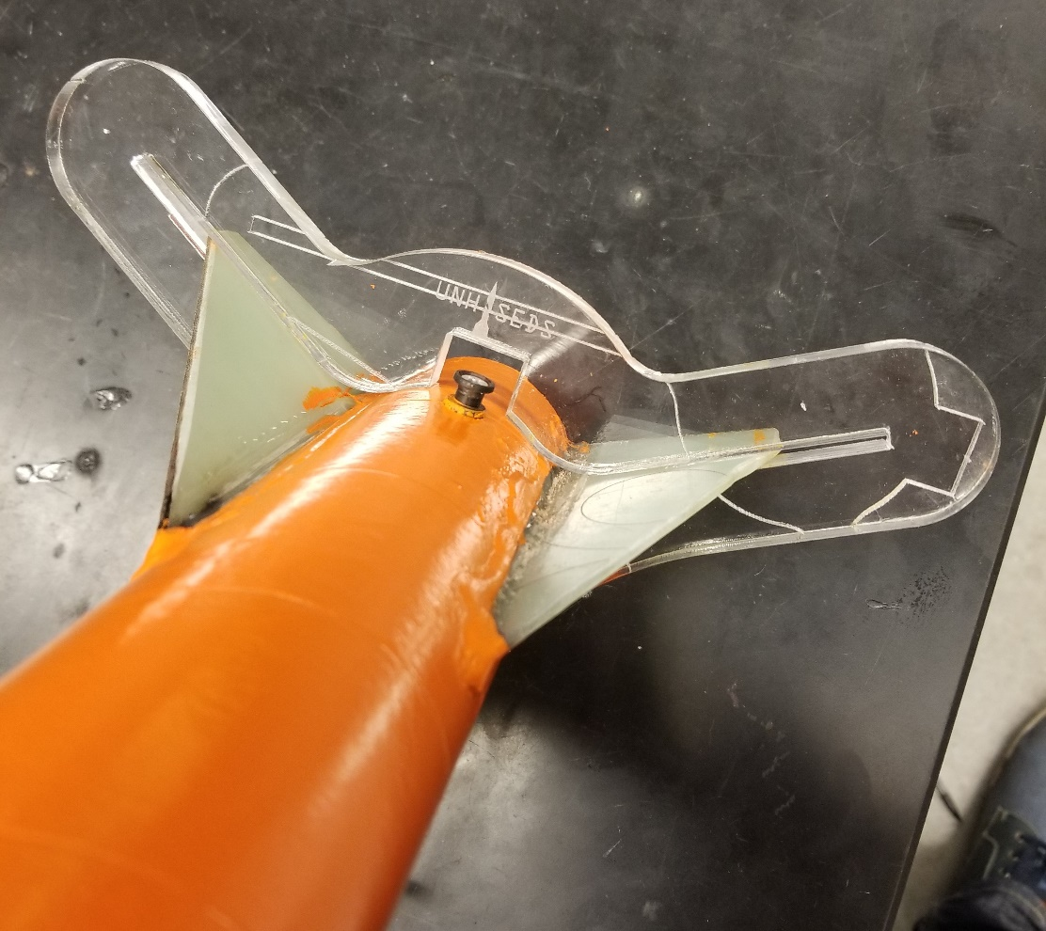
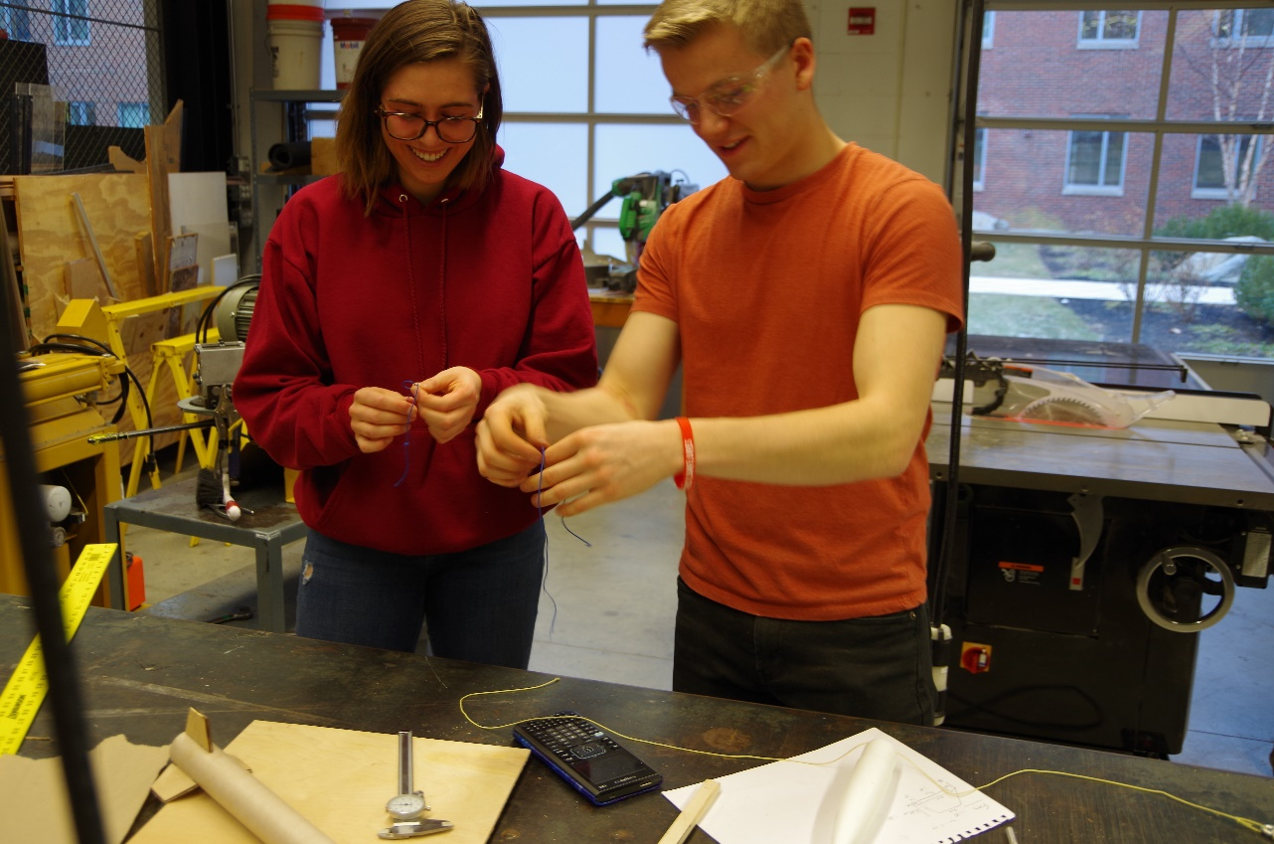
Department of Mechanical Engineering
Authors: Charlie Nitschelm, Kevin Bucher, Nick Clegg, Reilly Webb
Advisor: Dr. Todd Gross
Project Overview
To design, manufacture, and launch a high-powered, multi-stage rocket for the SEDS University Student Rocketry Competition
Goals
Design a high-powered engine class rocket to achieve maximum altitude
Implement a comprehensive recovery system that results in a fully reusable rocket
Constraints
Total combined engine impulse must not exceed 640.0 N-s
Must have at least two propulsion stages
Drogue Parachute
A small parachute deployed at sustainer apogee
Launch Simulation
Custom Nose Cone
A carbon fiber nose cone that houses the drogue parachute and connects directly to the electronics bay
Rocket trajectory was simulated using MATLAB. This required accurate stability, thrust, drag, and atmospheric models to produce ordinary differential equations that are then numerically solved for given rocket dimensions
Caliber is a measure of passive stability, and should remain between 1-3 for stable flight (right)
Electronics Bay
Houses the TeleMega GPS and controls both parachute deployment and sustainer ignition
Sustainer Parachute
A larger main parachute that
slows the sustainer to a safe landing speed
The MATLAB flight model is verified by comparing results to flight data from launches and to OpenRocket predictions (a pre-existing rocket simulation program)
 | Flight Data | OpenRocket Model | MATLAB Model
Sustainer Apogee | 1071.1 m | 1020.6 m | 1154.1 m
Booster Apogee | 290.0 m | 238.6 m | 276.3 m
Sustainer Engine
Propels the rocket to max altitude after booster burnout; 1.7 second burn time
Forward Fins
Provides stability to
the sustainer after stage separation
Check Integrity with Finite Element Analysis
Research Aerodynamic Theory
Optimize Rocket Dimensions
Staging Coupler
Supports stage separation at sustainer ignition
Manufacture and Assemble
Booster Parachute
A large parachute to slow the
booster to a safe landing speed
Improve
Aerodynamic Models
Rocket Improvement Cycle
Design & Analysis
An optimization program was created to determine the nominal dimensions for each component that will result in the highest simulated altitude.
An optimization program was created to determine the nominal dimensions for each component that will result in the highest simulated altitude
Launch and Gather Data
Booster Engine
Initiates flight with a
0.7 second burn time
Improve Manufacturing Techniques
Aft Fins
Provides stability to the rocket before stage separation
This was achieved by maximizing the height output from the combined aerodynamic models through nonlinear programming using the interior-point algorithm
Improve Field Launch Techniques
Propulsion
A Static Test Fire Rig was designed and manufactured to test the propulsion characteristics of each engine and to verify total engine impulse stays below 640.0 N-s
Optimization Constraints:
Maintain in-flight stability
Structural integrity factor of safety of at least 3.0
Manufacturing limitations
 | Reported Max Thrust | Measured Max Thrust | Reported Total Impulse | Measured Total Impulse
Booster Engine: Cesaroni H399 | 545.8 N | 549.6 N | 282.2 N-s | 277.1 N-s
Sustainer Engine: Cesaroni I204 | 356.8 N | 329.7 N | 347.7 N-s | 322.7 N-s
Manufacturing
Stress analyses are performed on the optimized components that are prone to failure, such as the engine centering ring (left)
A laser cut fin alignment tool was designed to keep fins in place during the epoxy curing process
Many components are assembled from scratch such as the nosecone, fins, ignition leads, ejection charges, and launch pad
Data acquisition was performed using the custom test rig, a 150 lb load cell, and NI SignalExpress software
Results were verified by comparing to official data reported by the engine manufacturer
Optimization must be reconfigured if resulting FOS is less than 3.0
Acknowledgments
A huge thanks to all the members of UNH SEDS, Prof. Martin Wosnik, Alireza Ebadi, Thomas Collins, the Parents Association, and our advisor Todd Gross for all the support

Slide 2
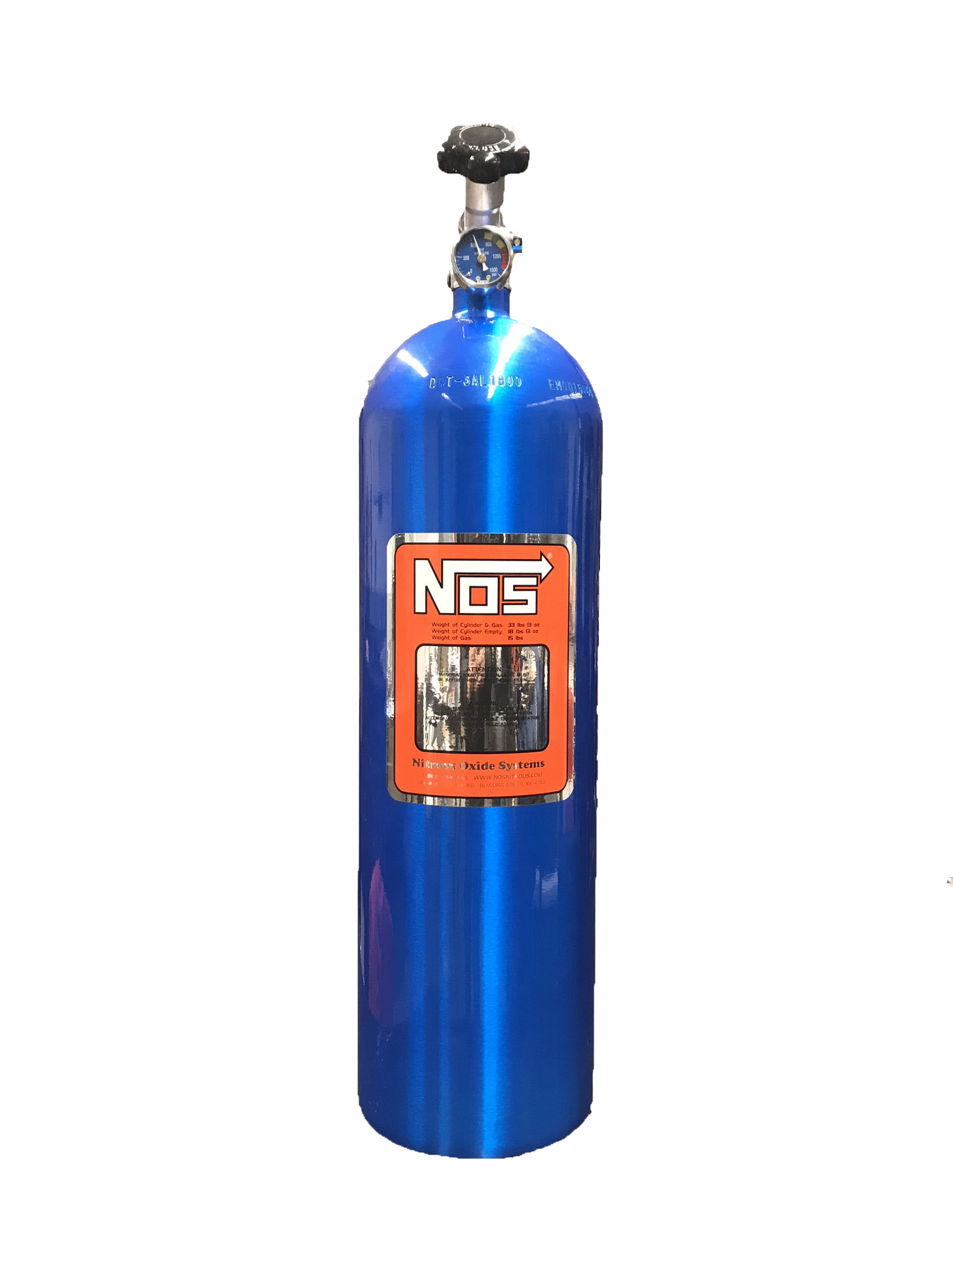
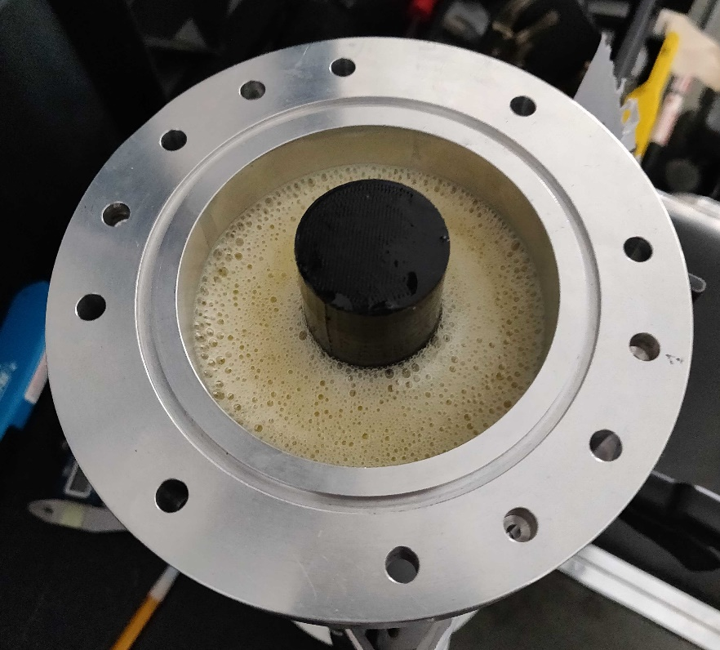
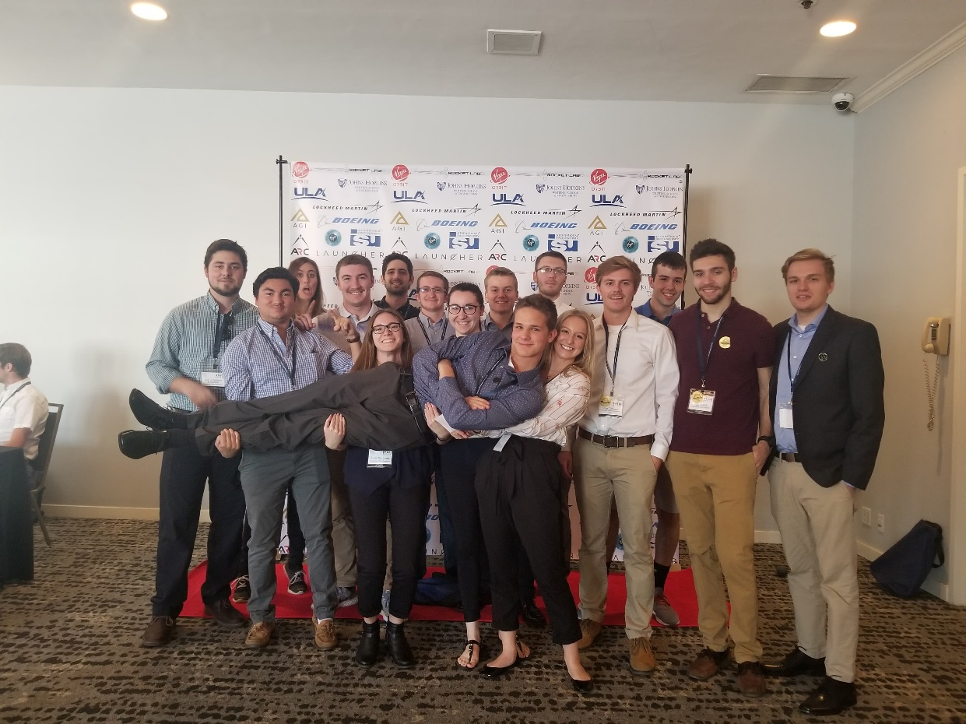
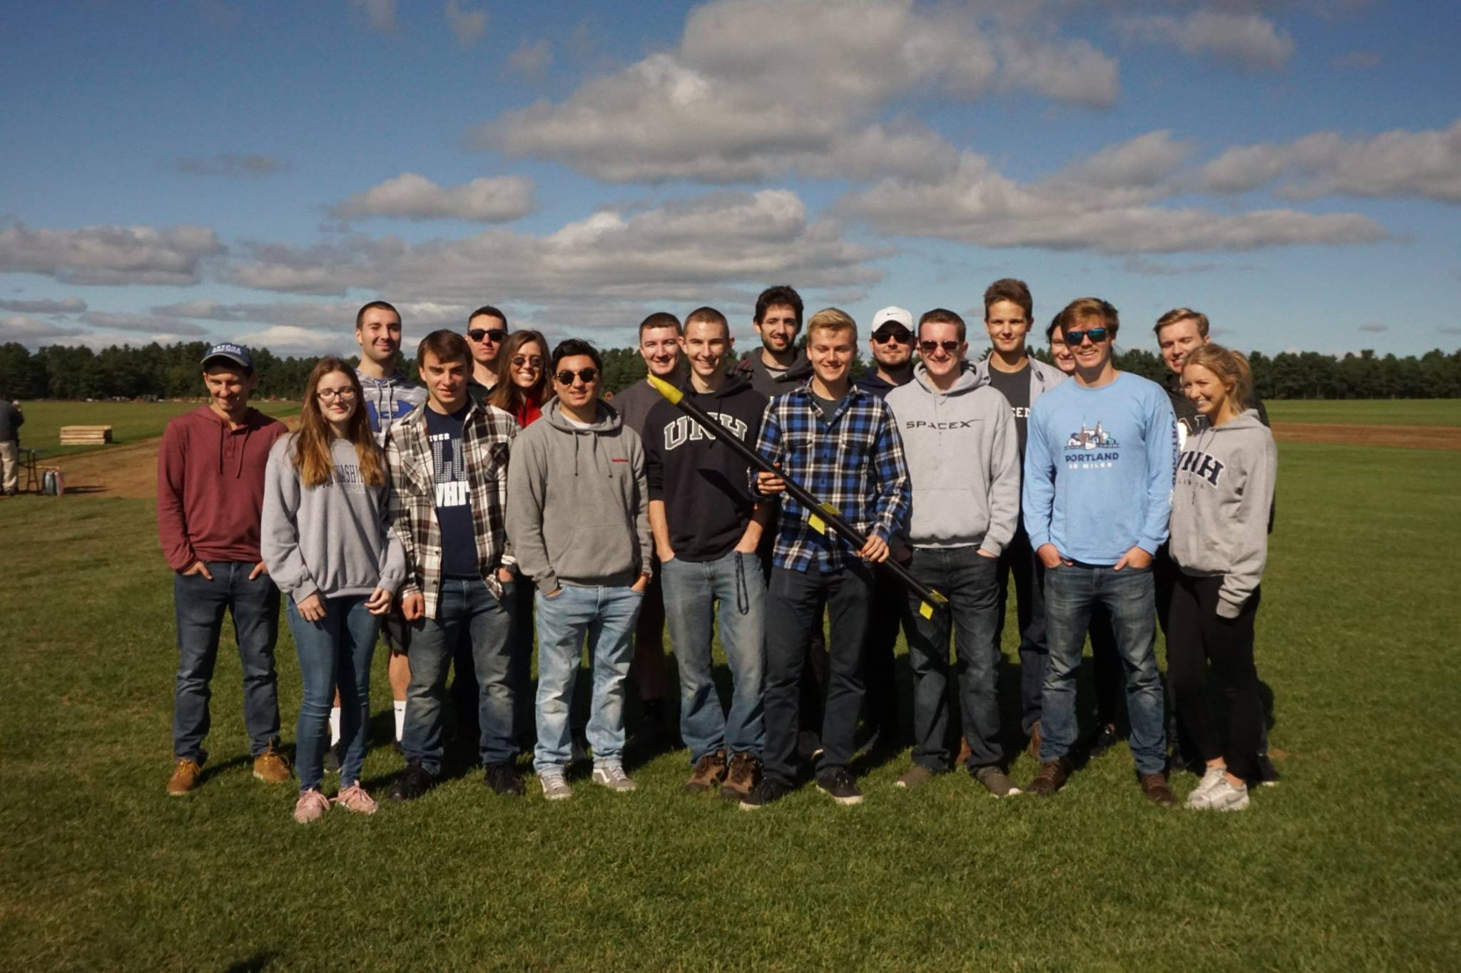
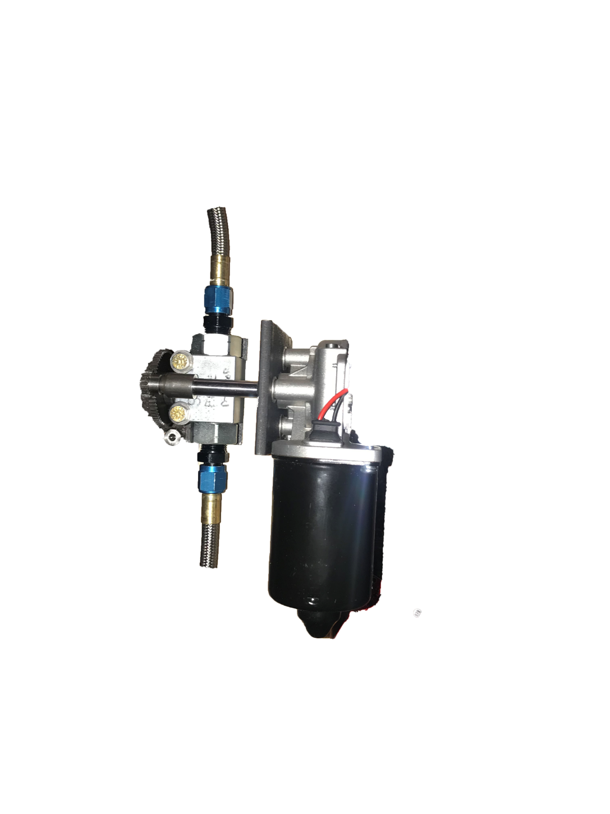
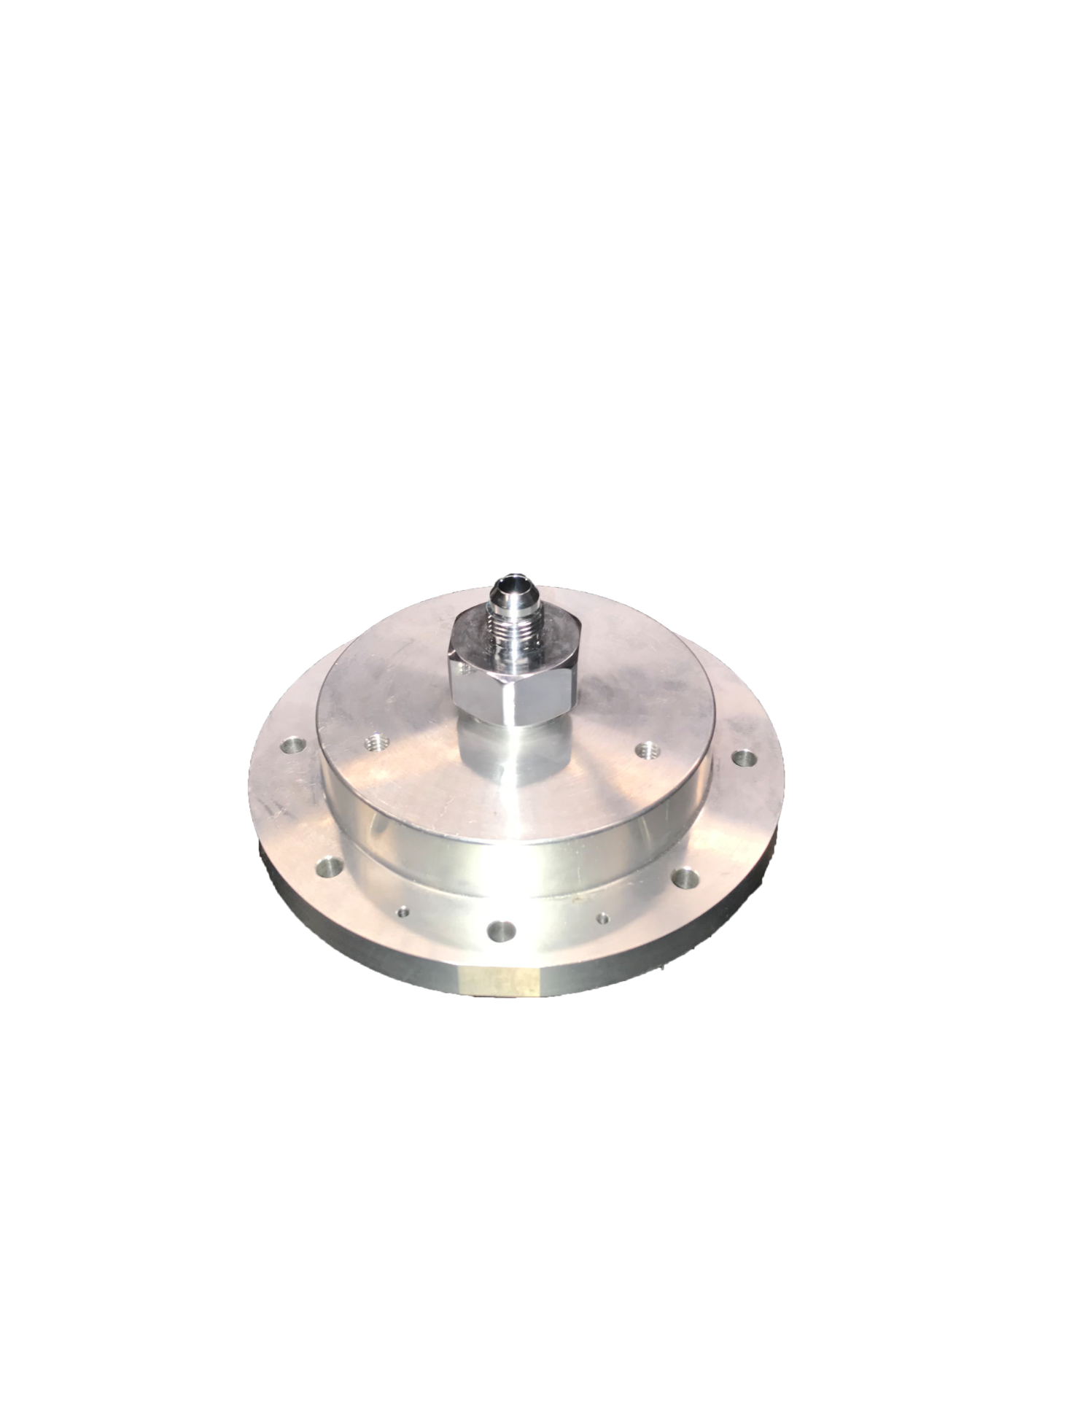
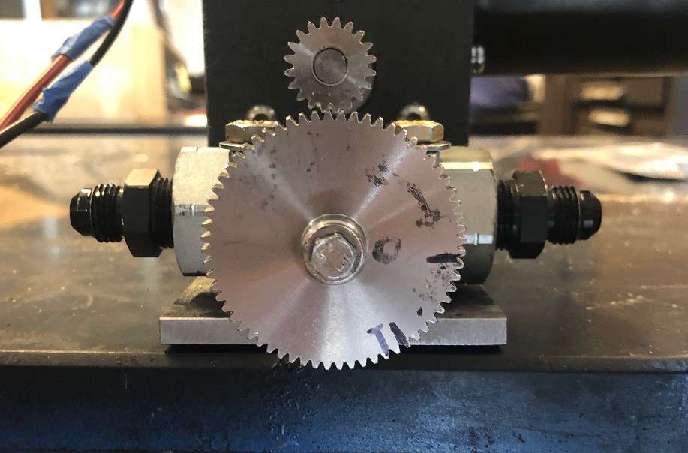
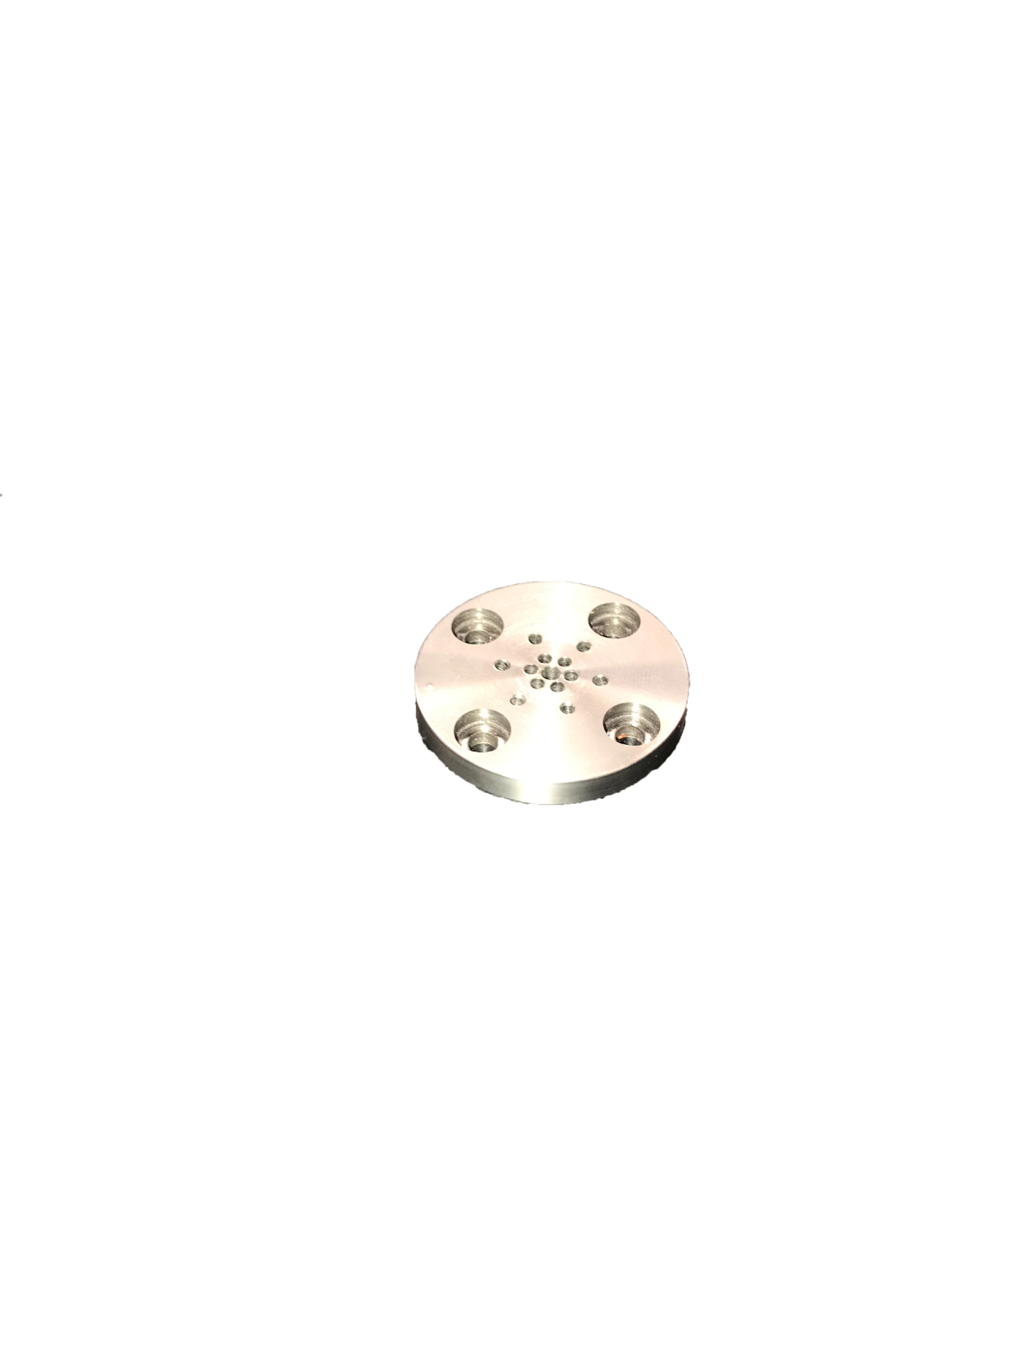


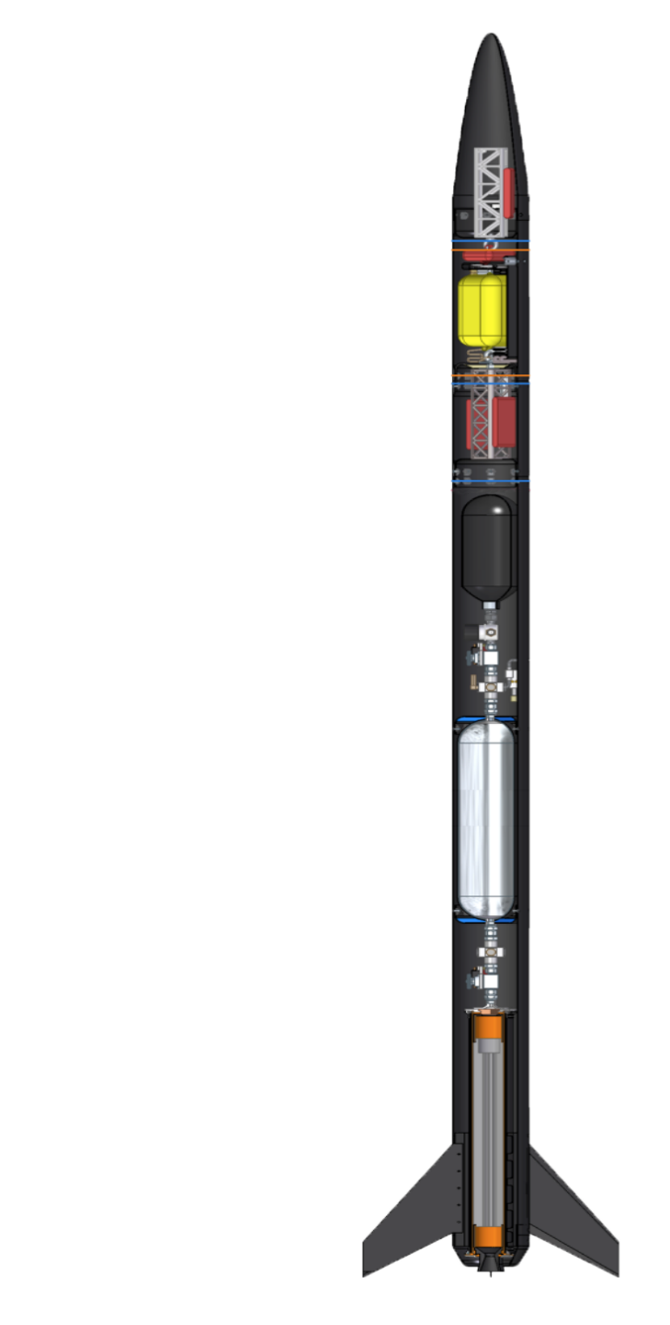
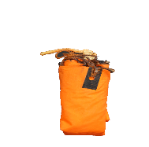
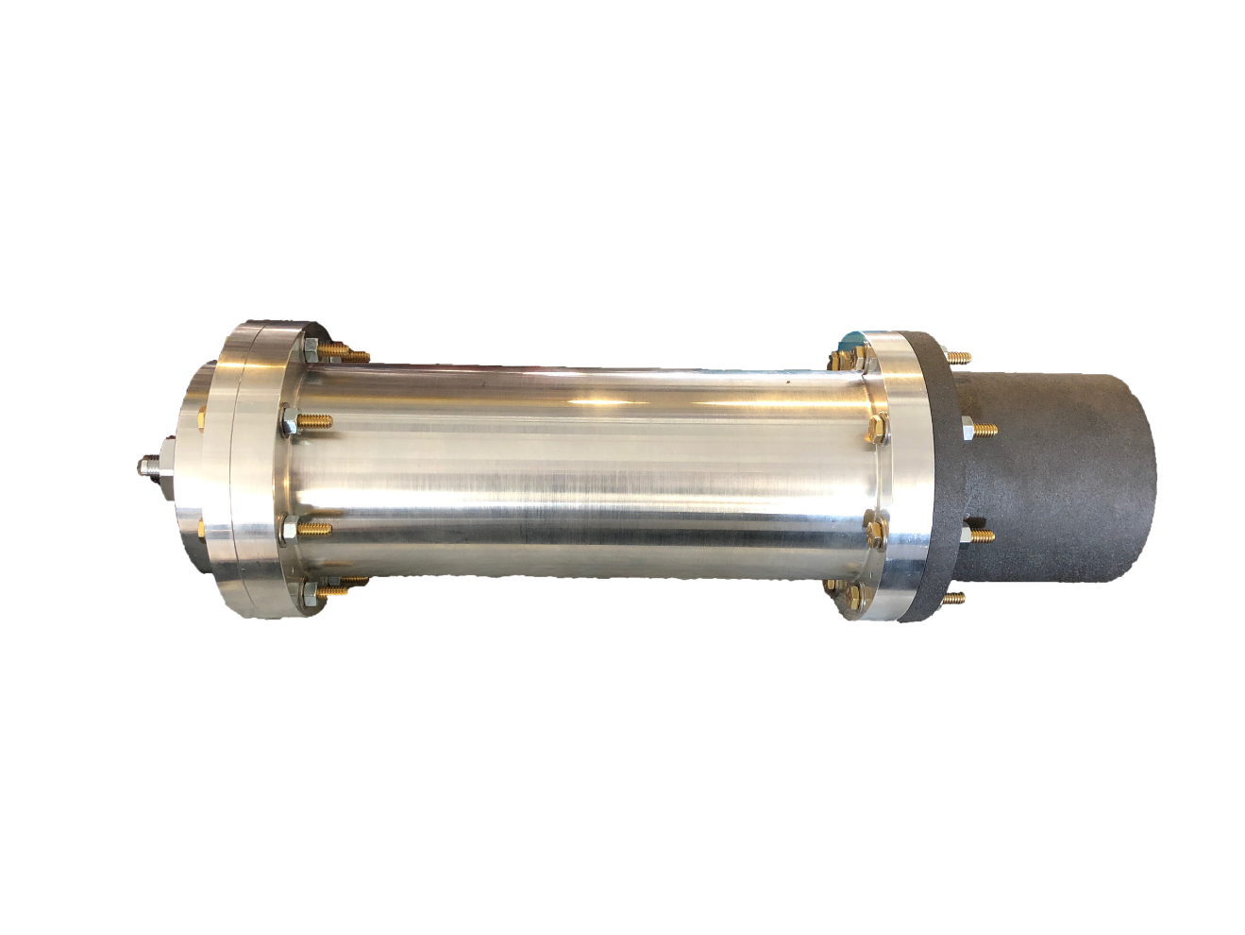

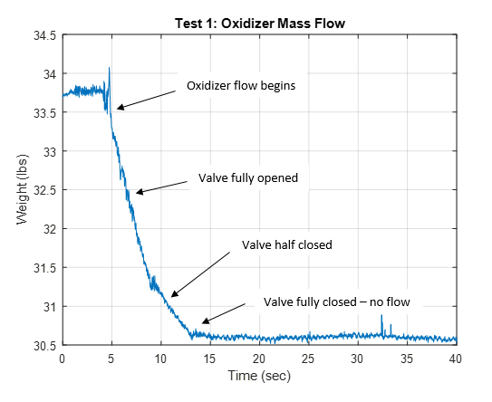
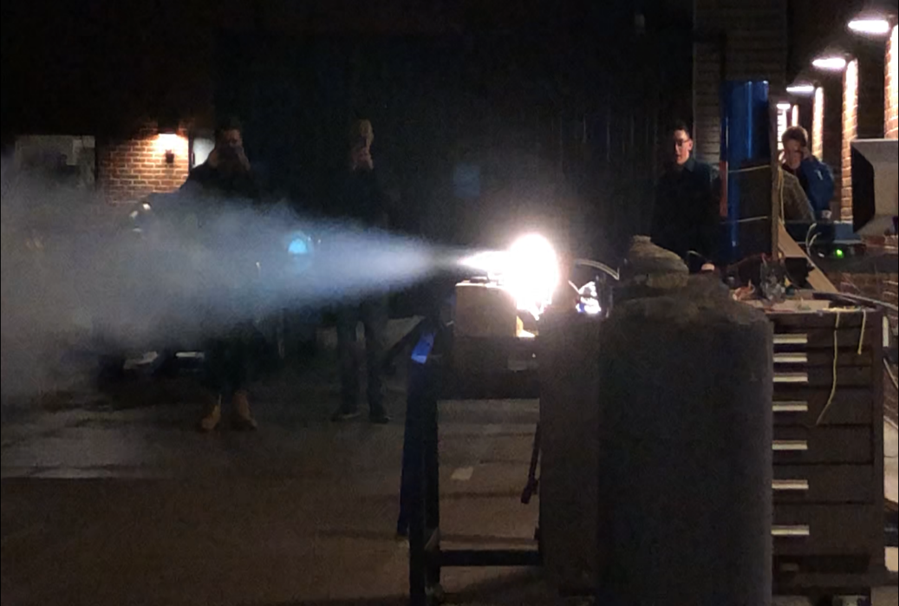

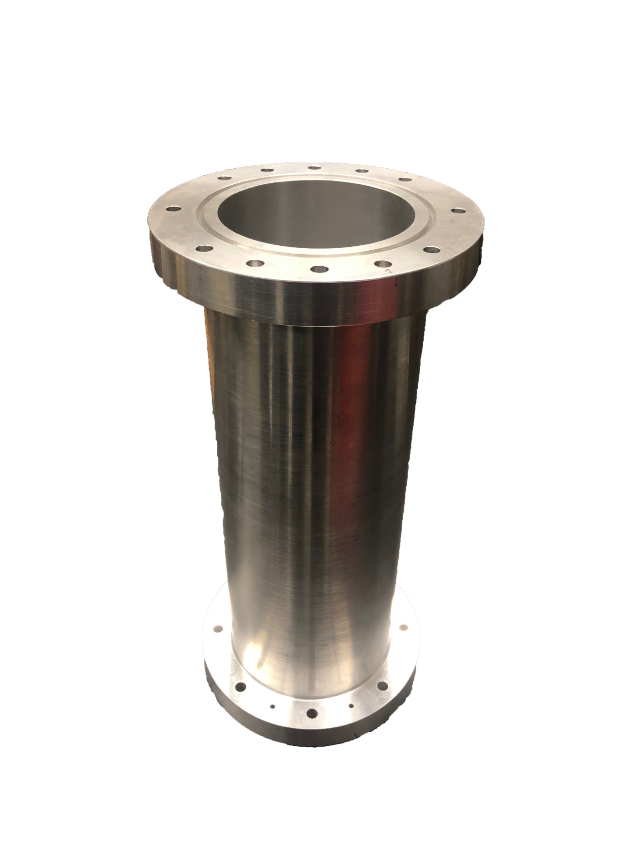
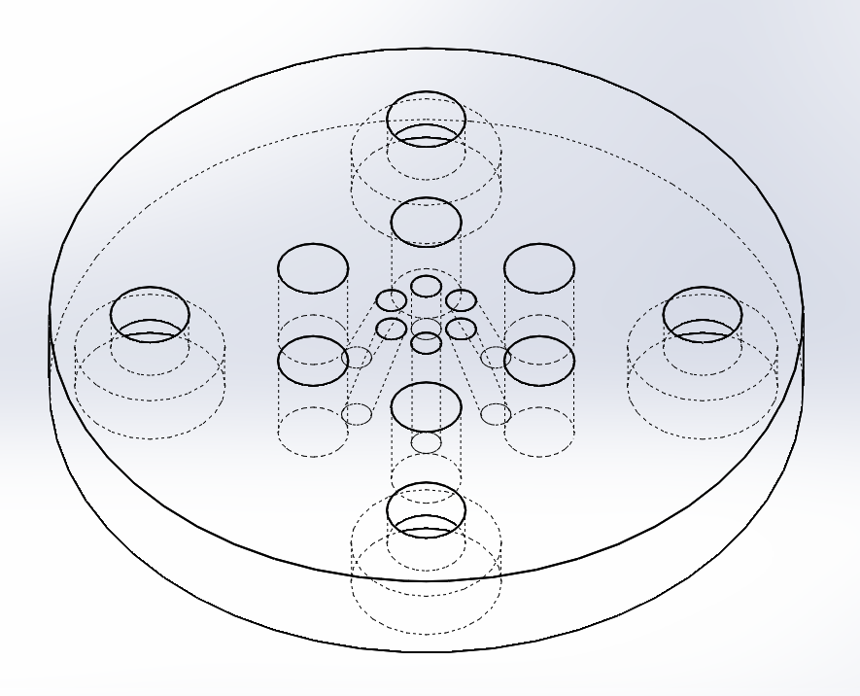

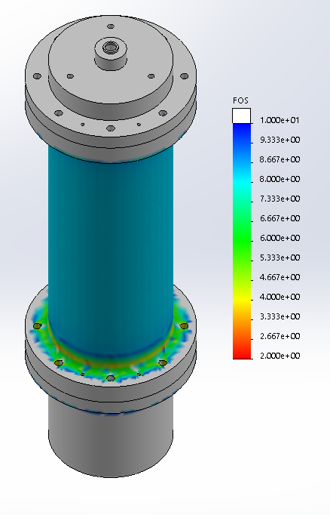
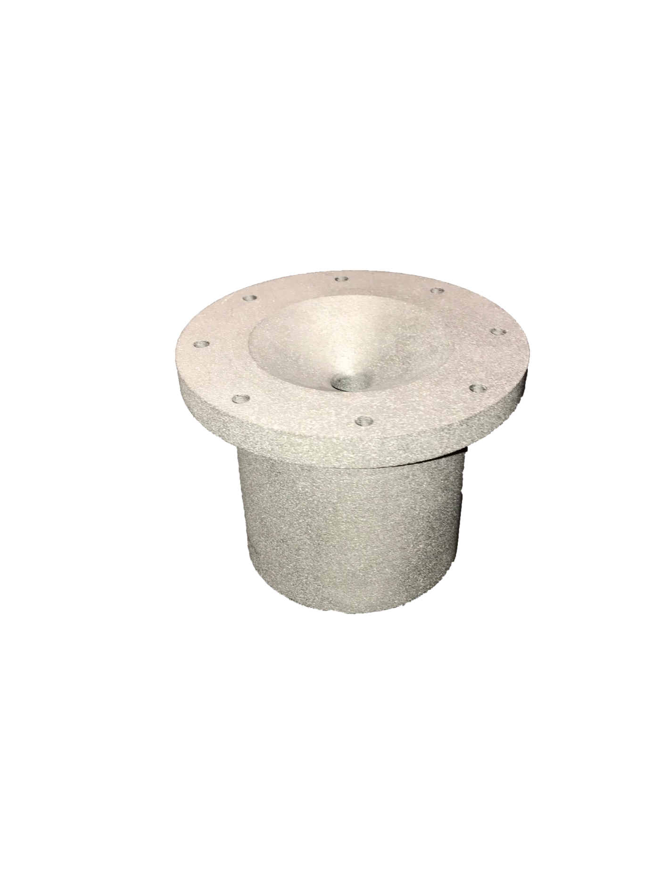
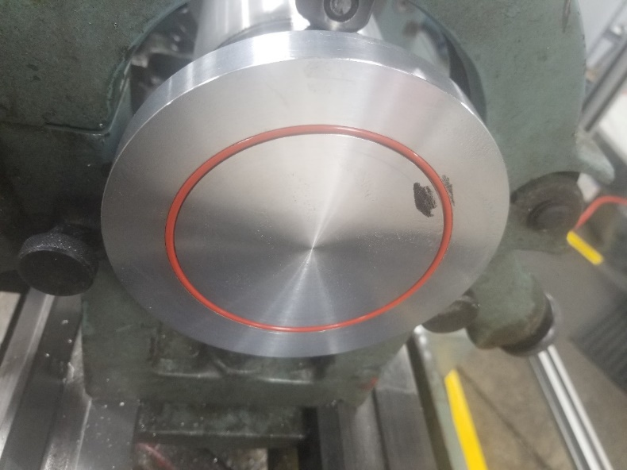
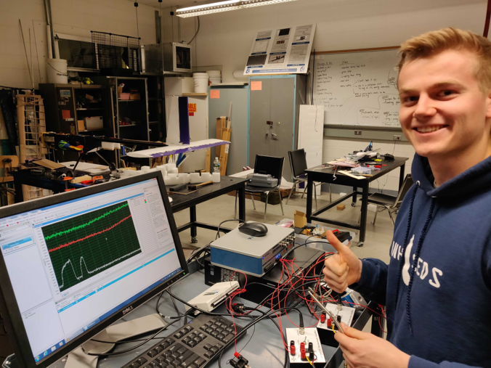
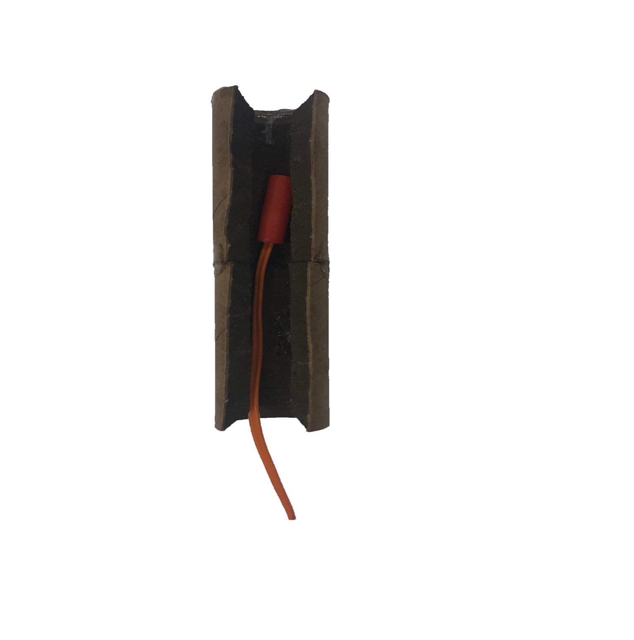
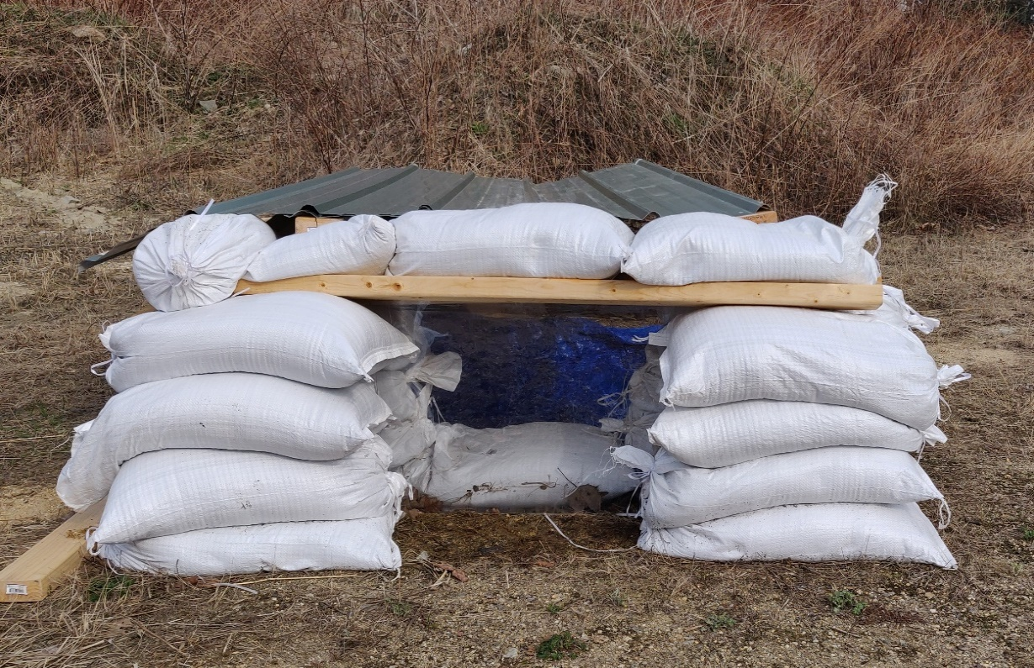
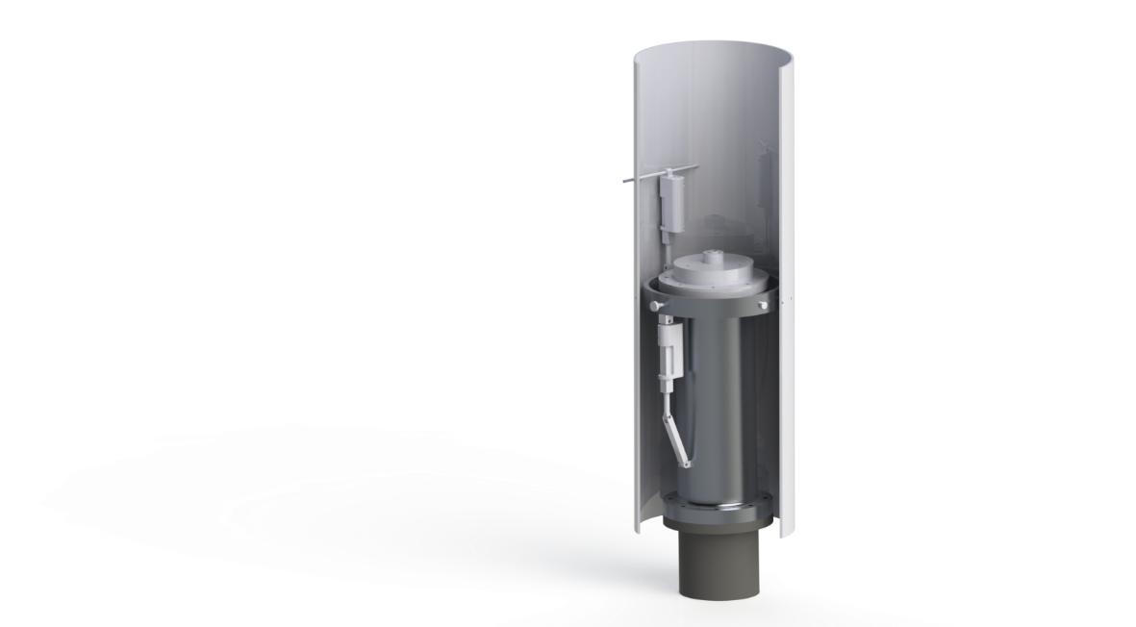
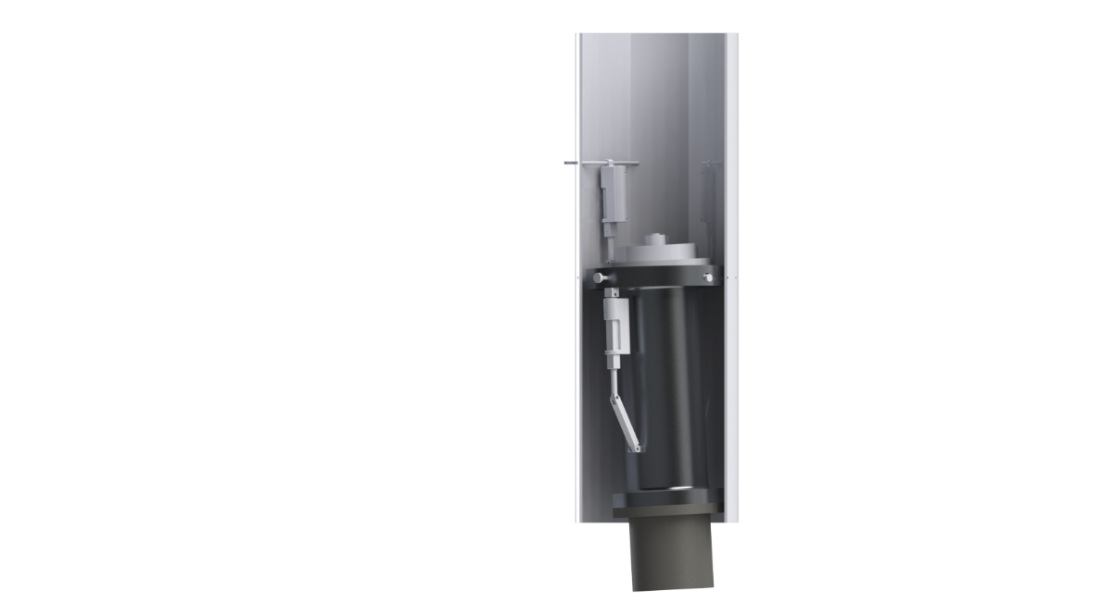
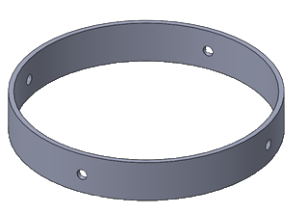
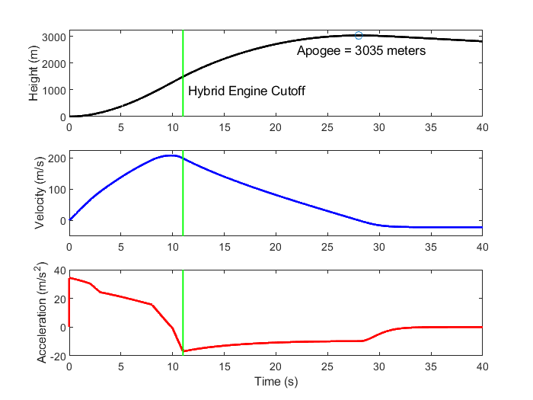
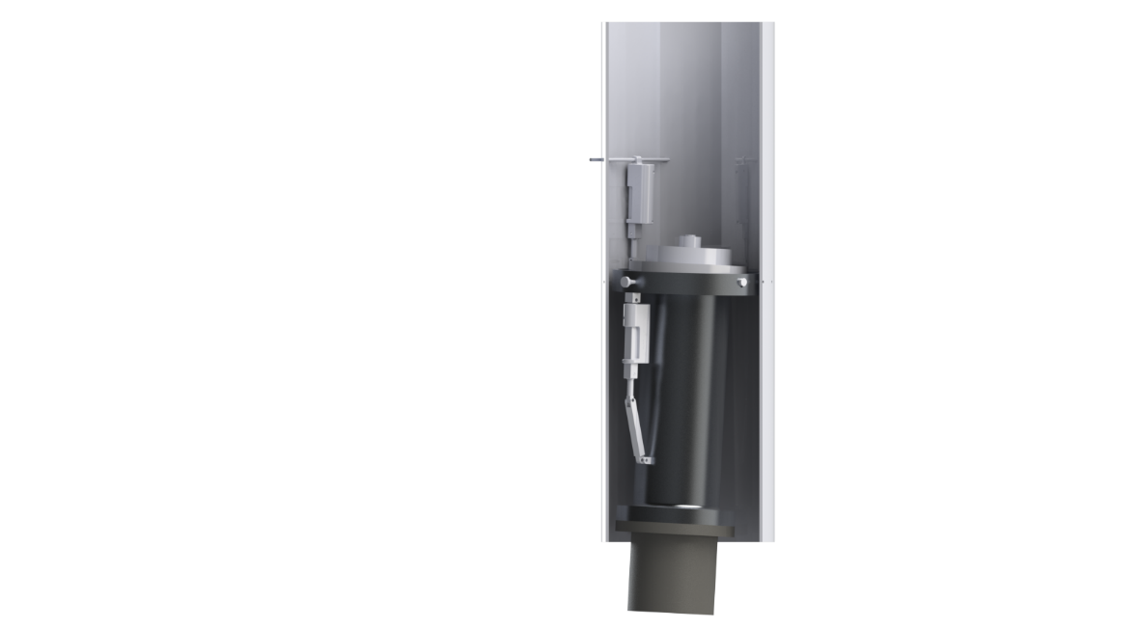
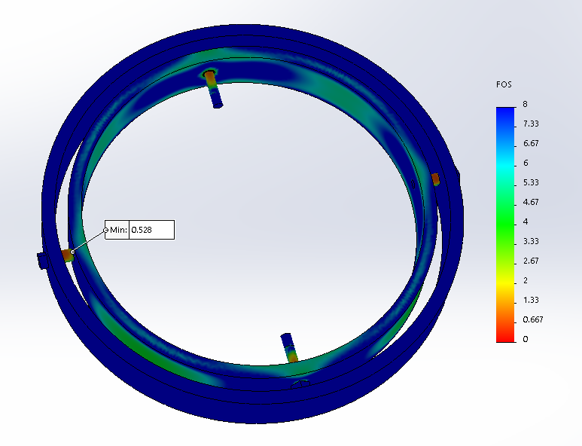
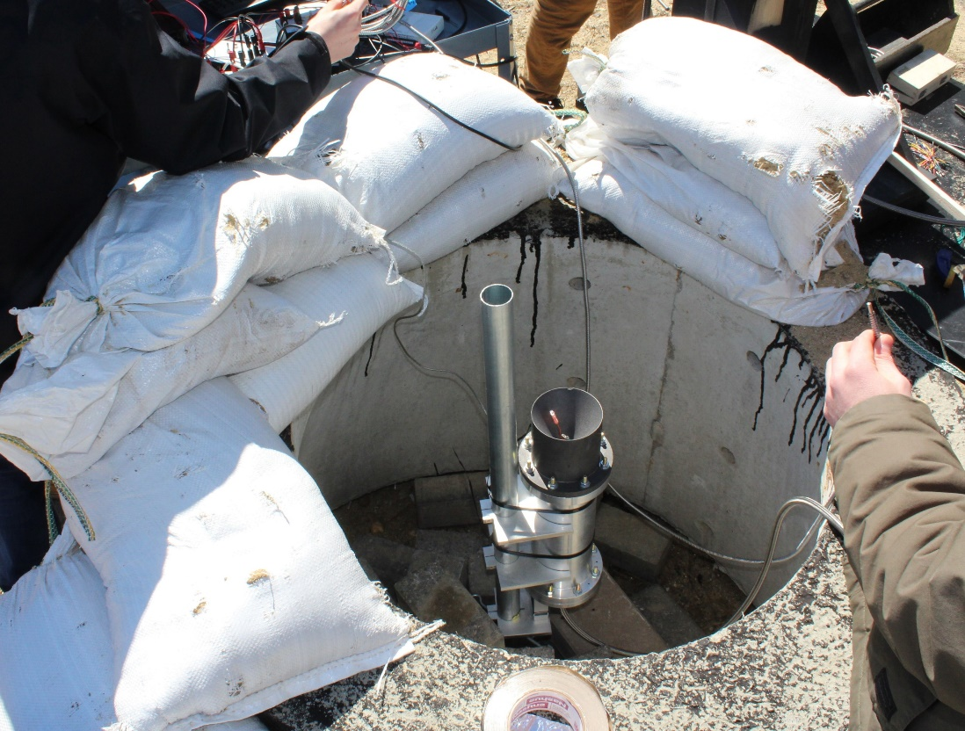
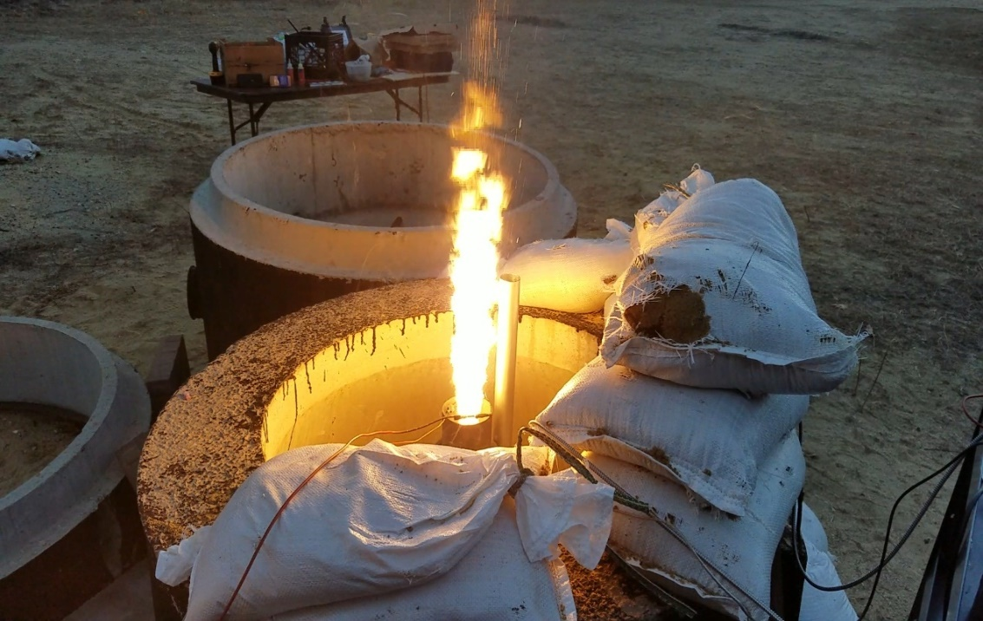
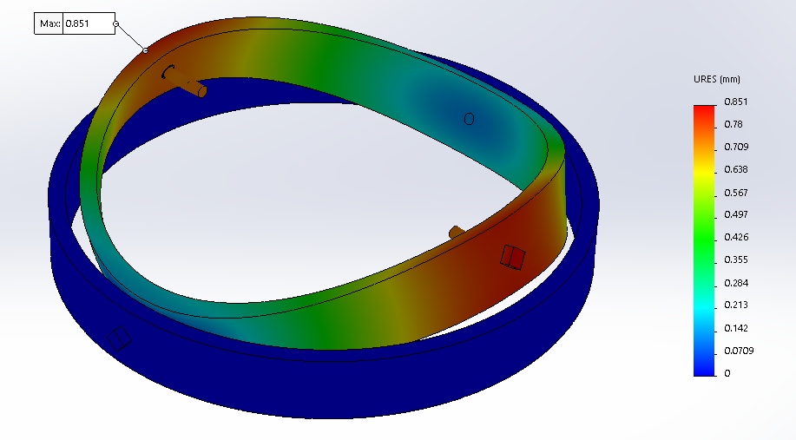
Department of Mechanical Engineering
Authors: Ryan Blatti, Thomas Collins, Chase Eldridge, Andrew Hosman
Silas Johnson, Tyler Landry, John Langer, Charlie Nitschelm, Collin Stroshine Advisor: Dr. Todd Gross
Who We Are
A second year engineering organization comprised of students of all classes and CEPS majors
A primary engineering goal of pursuing the art of high power rocketry with custom-made hybrid engines
Fuel Selection and Flow Regulation
Oxidizer Tank
A highly pressurized vessel that
contains liquid Nitrous Oxide,
acting as our oxidizer within
the combustion chamber
Hydroxyl-terminated polybutadiene (HTPB) and liquid nitrous oxide were chosen as the reducer and oxidizer, respectively.
A mold was 3-D printed to form the HTPB into a circular grain.
Flow Regulator
A motorized valve that monitors flow regulation
of the oxidizer into the injection plate controlled
by an electric motor and
an Arduino.
The flow regulator controls the amount of flow into the combustion chamber, permitting throttle, cutoff, and reignition
SpaceVision, November 2018
SEDS Rocketry Competition, October 2018
The 3 Year Plan
Injection Plate
Responsible for providing desired oxidizer flow into the combustion chamber with the assistance of the impinging plate
Oxidizer Injection
Year One
Year Three
Various impinging plates were designed to be tested for ideal atomization of the nitrous oxide for maximum efficiency within the combustion chamber
Hybrid Engine
Design
Manufacture
Test
A cold fire test was designed to study overall oxidizer flow characteristics and allow a desired oxidizer flow rate of 1.5 lb/sec to obtain an engine burn time of 10 seconds
Impinging Plate
An interchangeable cylindrical plate responsible for the impingement and atomization of the oxidizer flow streams
Runaway
Rocket Building
Simulating
Launching
Optimizing
Hybrid Rocket
Engine Optimization
Rocket Integration
Competition
Combustion Chamber
An enclosed volume where the solid reducer and liquid oxidizer react to produce a superheated, highly pressurized chamber of gas
Year Two
Combustion and Ignition
Hot Fire Test
Incoming nitrous oxide impinges and atomizes saturating the fuel within the combustion chamber producing vast amounts of hot, dense gases.
A river of hot gases flow through the graphite De Laval nozzle, converting its thermal energy into kinetic energy.
Worked with the UNH police and fire departments to locate a safe testing range and procedures.
Test engine to determine thrust, mass flow rate, combustion temperature and overall functionality.
Load cells and thermocouples were used to record data required for future optimization.
Designed and manufactured a static test fire rig to secure the engine and withstand a force up to 500 lbs of thrust.
Three hot fire tests were attempted, but due to weather, failed ignition and flow regulation a successful test has yet to be completed.
Nozzle
Graphite was machined into a de Laval curve responsible for directing the flow of hot gases outside of the combustion chamber into the environment providing thrust
An igniter device is utilized to produce hot gases within the combustion chamber in preparation for oxidizer flow through the impinging plate.
Thrust Vectoring
Current Work
4 steel pins are used to allow rotation of the hybrid engine while maintaining even distribution of thrust to the entire rocket
Improve flow regulation design by reworking gears
Successfully test hybrid engine and work towards an optimum design using STFR V2
Integrate thrust vectoring system onto the propulsion system
Create accurate launch simulations with real-life data from the hybrid engine and rocket geometry
A gimbal ring is used to provide a second rotational piece that is placed between the engine and the rocket body
Acknowledgments
A huge thanks to all the members of UNH SEDS, Scott Campbell, Dr. Ivo Nedyalkov, Dr. Alireza Ebadi, Sheldon Parent, Andy Globe, Dave Emanuel, Chief Dean, Ronald O’Keefe, TURBOCAM International, Reilly Webb, the UNH Makerspace and our advisor Dr. Todd Gross for all the support
Two actuators positioned 90 degrees apart enable real-time pitch and roll control

Slide 3




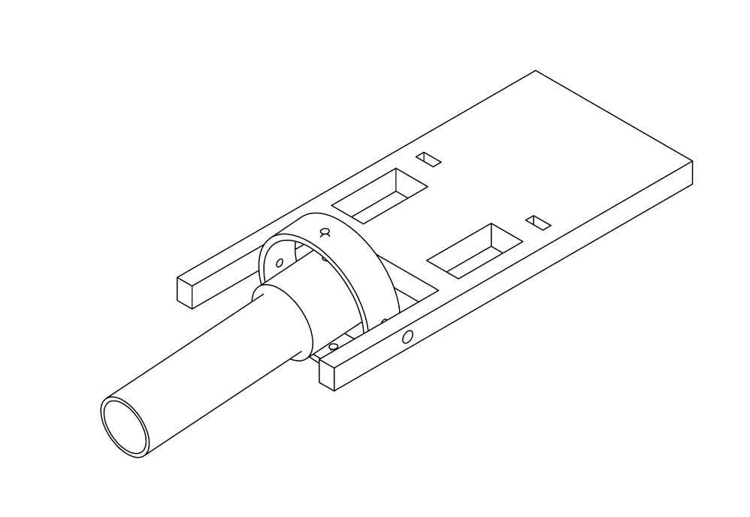
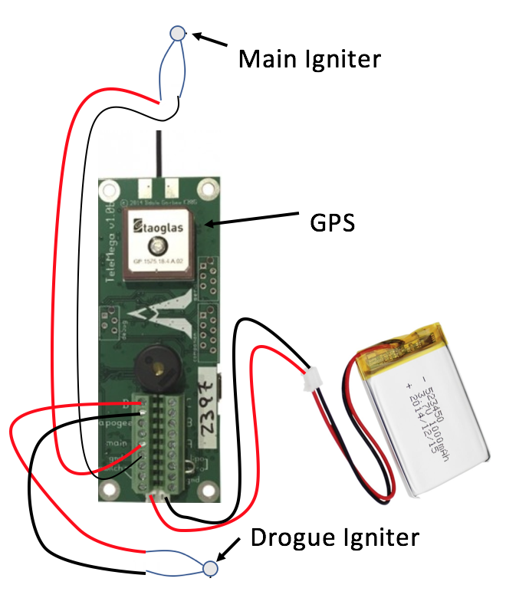

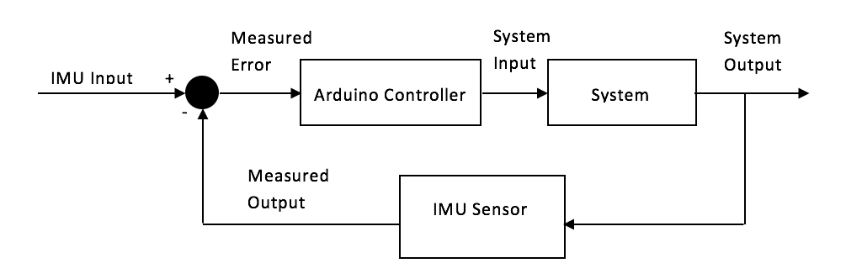
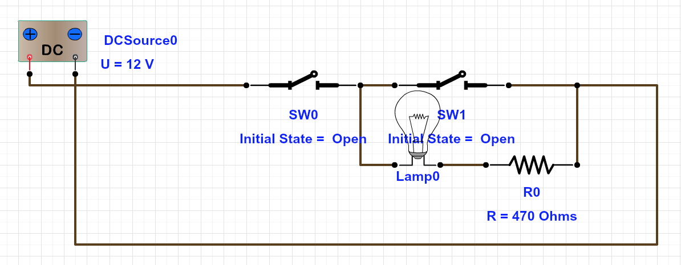

Daniel Nemr Advised by Dr. Pablo Yoon Department of Electrical and Computer Engineering
Project Overview:
SEDS is a a non-profit organization that empowers young students to participate in nationwide projects and events. The team has decided to enter this year’s University Student Rocket Competition (USRC), where a high power two-stage rocket will be designed and manufactured to reach the highest altitude against the opposition. This project mainly focuses on the electrical components associated with high-power rockets such as:
An electrical launcher
Stabilization system
Parachute deployment
Stabilization System:
The purpose of the stabilization system is to guide a rocket vertically after the initial liftoff of a rocket. The stabilization system has two main roles during the launch of a rocket:
To ultimately provide horizontal and vertical
stabilization
2. To control the engine’s thrust vector and
counteract the orientation of the rocket
Parachute Deployment:
The rules of the competition state that the two-stage high-power rocket must land safely and should be compatible for multiple launches. Parachute deployment is a dire part of this competition because manufacturing other rockets isn’t cheap due to the electronics and types of materials used. Ideally, the system must do 3 functions:
Deploy a drogue chute at apogee
Deploy a main chute at 500 ft. (or
any altitude found necessary to
reduce descent drift)
3. Sense when the rocket reaches
apogee, and the altitude when the
main chute deploys
Stabilization System Assembly:
The stabilization system was assembled using a 6-axis MPU6050 sensor, an Arduino Nano microcontroller, and two servo motors for the x and y axis of the engine’s thrust
The MPU6050 tells the Arduino which direction the rocket is facing
The Arduino then sends instructions on which way the servo motors should move
The servo motors are attached to x and y gimbals which control the direction of the engine’s thrust
All electronics are housed on
a customized acrylic chassis
An Arduino Nano is used because of
its compact size, compatibility,
and 16 MHz clock speed
Parachute Deployment Data:
The data below displays the following:
The rocket reached an
altitude of 2119 ft.
The drogue chute deployed
at apogee
3. There was a voltage drop at
roughly 500 ft. causing the
main chute not to deploy
Electrical Launcher:
Three purposes to the electrical launcher:
The launcher must deliver enough electrical current to ignite the pyrogen coated igniter, thus sparking the motor (at least 1.5 amps for one full second)
The launcher must include a
safety mechanism so that it is safe
for someone to prep the rocket for
launch
3. The launcher must guide
the rocket until it has
attained enough airspeed
for the stabilization system
to safely guide the rocket
The data below displays the following:
The rocket reached an
altitude of 2119 ft.
The drogue chute deployed
at apogee
3. There was a voltage drop at
roughly 500 ft. causing the
main chute not to deploy
Conclusions:
The USRC will be taking place in October of 2018, but there are conclusions that can be made from what has been designed and implemented so far:
The launcher provides enough current to ignite the pyrogen and start the engine
The stabilization system can implement gimbal thrusting, but testing must be done to verify amplitude improvement and stability.
Parachute deployment can deploy a chute at apogee and at 300 ft. while also being able to track the rocket during flight
Accelerometer Use (MPU 6050):
The MPU6050 is an accelerometer and gyroscope which reads the x, y and z axes for both implementations. The accelerometer was utilized for two reasons:
To sense the orientations in the x and y directions of
the rocket
2. To send the Arduino Nano the direction of the rocket
so the servo motors can counteract the orientation of the
rocket using gimbal thrusting

